Slide 1
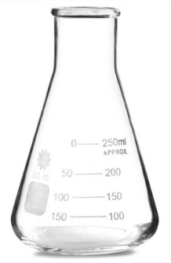
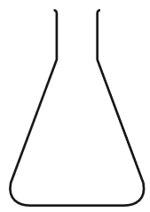
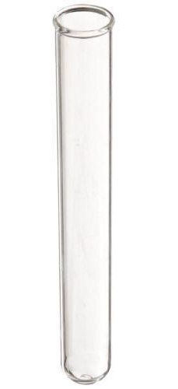

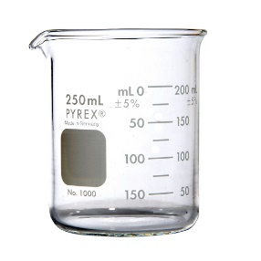
Daily Review
Scientists use specialised equipment to conduct experiments. We draw diagrams of equipment as a 2D outline.
Draw the scientific diagram of a beaker on your whiteboard.
Tell the person next to you two ways these pieces of equipment are similar.
Tell the person next to you one more piece of equipment that will fit in this group. Be ready with a reason for your choice.
Conical flask
Test tube
Beaker

Slide 2
Apparatus Year 7 Science

Slide 3
Learning Objective
CFU
What are we going to learn today?
Draw scientific diagrams of apparatus used for an experiment.
Activate Prior Knowledge
Think, Pair, Share: Name three pieces of scientific equipment and their functions.
Vocabulary
Apparatus: collection of equipment used together Function: Use or purpose

Slide 4
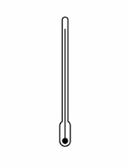


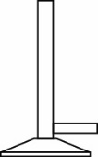
Concept Development
CFU 1
How is an apparatus different to a piece of equipment?
Scientists use specialised equipment to conduct experiments.
Equipment placed together for an experiment is called an apparatus.
The diagram below shows the apparatus used to heat water. What individual pieces of equipment can you identify? List them on your whiteboard.
Vocabulary
Apparatus: collection of equipment used together

Slide 5
Skill Development/Guided Practice
CFU 1
How large should your diagrams be?
Scientists use specialised equipment to conduct experiments.
Equipment placed together for an experiment is called an apparatus.
CFU 2
What two items from you pencil case do you use to draw scientific diagrams?
Steps for drawing scientific diagrams:
Diagrams should be approximately 1/3 of the height of the page.
Draw a simple outline of each piece equipment from a side view using a pencil and a ruler.
Write labels neatly and connect them to the diagram with a straight line.
CFU 3
How should each piece of equipment in your diagram be drawn?
Vocabulary
Apparatus: collection of equipment used together

Slide 6
Skill Development/Guided Practice
CFU 1
How is each piece of equipment drawn?
Scientists use specialised equipment to conduct experiments.
Equipment placed together for an experiment is called an apparatus.
CFU 2
How are the labels connected to the equipment?
Steps for drawing scientific diagrams:
Diagrams should be approximately 1/3 of the height of the page.
Draw a simple outline of each piece equipment from a side view using a pencil and a ruler.
Write labels neatly and connect them to the diagram with a straight line.
thermometer
beaker
gauze mat
tripod
Bunsen burner
heatproof mat
Vocabulary
Apparatus: collection of equipment used together

Slide 7
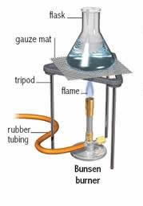
Skill Development/Guided Practice
CFU 1
This is not a scientific diagram. Explain to the person next to you why it isn’t a scientific diagram.
Scientists use specialised equipment to conduct experiments.
Equipment placed together for an experiment is called an apparatus.
Steps for drawing scientific diagrams:
Diagrams should be approximately 1/3 of the height of the page.
Draw a simple outline of each piece equipment from a side view using a pencil and a ruler.
Write labels neatly and connect them to the diagram with a straight line.
Vocabulary
Apparatus: collection of equipment used together

Slide 8
Relevance
This will help you be able to understand scientific diagrams so you can set up apparatus for experiments correctly.
Doing this will also help you draw how you have set up your equipment in student-planned investigations, so that other people can replicate your experiment.
Vocabulary
Apparatus: collection of equipment used together

Slide 9
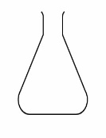

Skill Closure
On your whiteboard, write the names of the following pieces of equipment and their function.
Skill Closure
A student has drawn a diagram of the apparatus she used to filter a solid out of some water. Tell the person next to you two things she has done wrong in her diagram.
Skill Closure
Redraw the diagram of the apparatus as a scientific drawing.

Slide 10
Independent Practice
There are three different apparatus set up around the room. In your Science book, draw a scientific diagram of each one. Make sure you follow the rules for scientific drawing.
Apparatus 1: Test tubes in a rack
Apparatus 2: Heating a test tube
Apparatus 3: Evaporating a solution

